Slide 1
Visualization of US Wildfire Data
By Aldo Zepeda & Hongbo Wang
Team 8

Slide 2

Data Sources and Information
A SQL database with entries of over 1.88 million US based wildfires.
Spans 24 years from 1992 to 2015.
Includes fire size, location, cause and
34 other data features.
From The United States Forest Service
Spatial wildfire occurrence data for the United States, 1992-2015 [FPA_FOD_20170508] (4th Edition)
by Karen C Short (2017)

Slide 3
Goals
To visualize the fire data in maps to show size and locations of fires
To visualize changes in number and size of fires from 1992 to 2015
To determine largest contributors to wildfires
To display other important information through charts and graphs

Slide 4
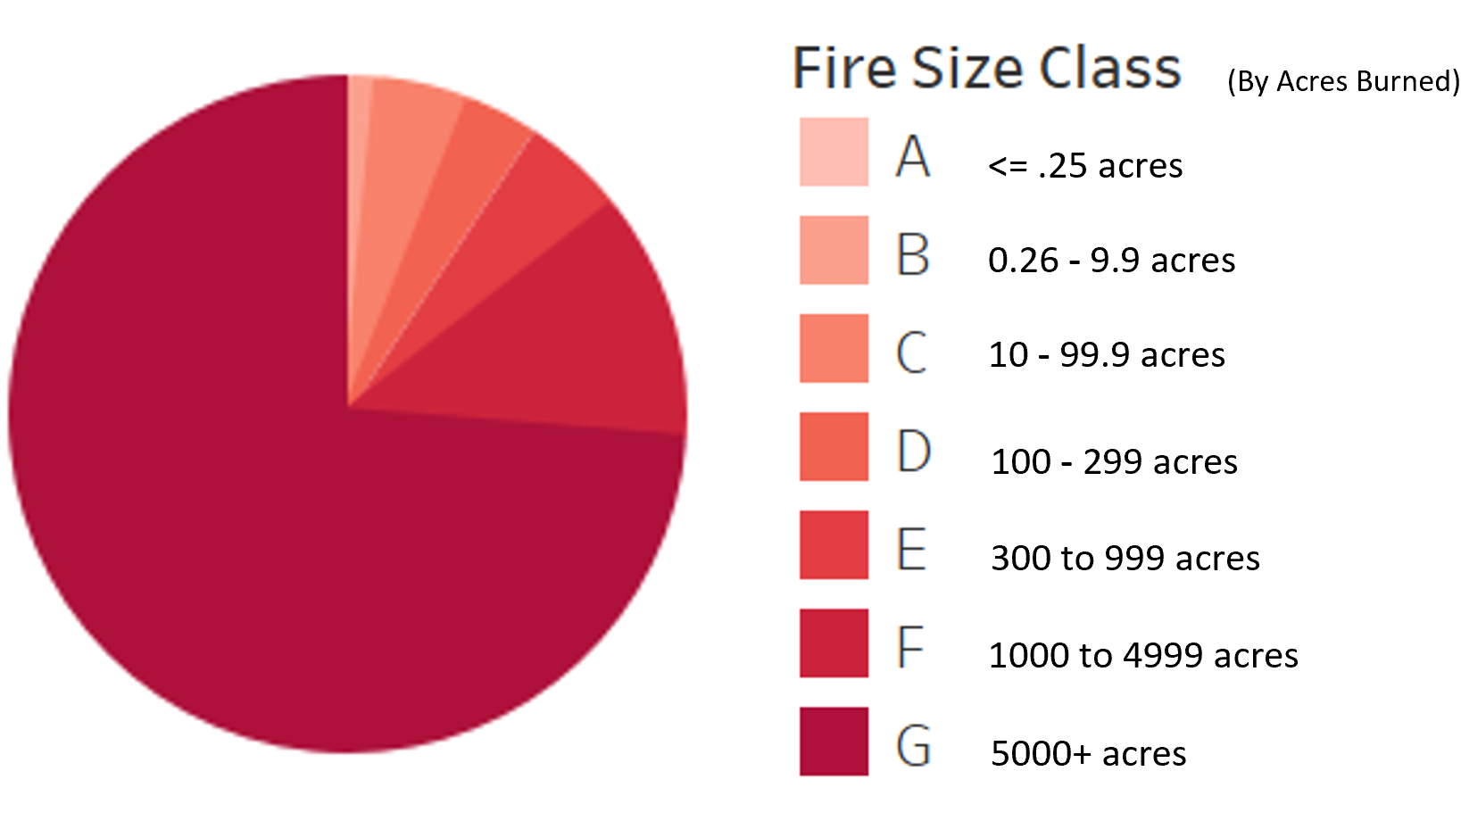
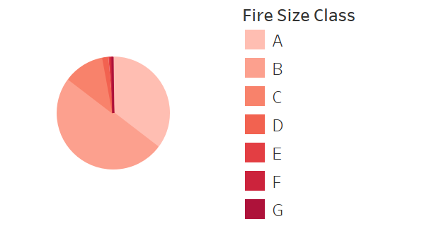
Comparison of Fire Classes
Acres Burned per Fire Class
Number of Fires by Class
# of fires per class
667k
939k
220k
28.4k
14.1k
7,786
3,773
*140 million acres burned between 1992 and 2015
*1.8 million wildfires between 1992 and 2015

Slide 5
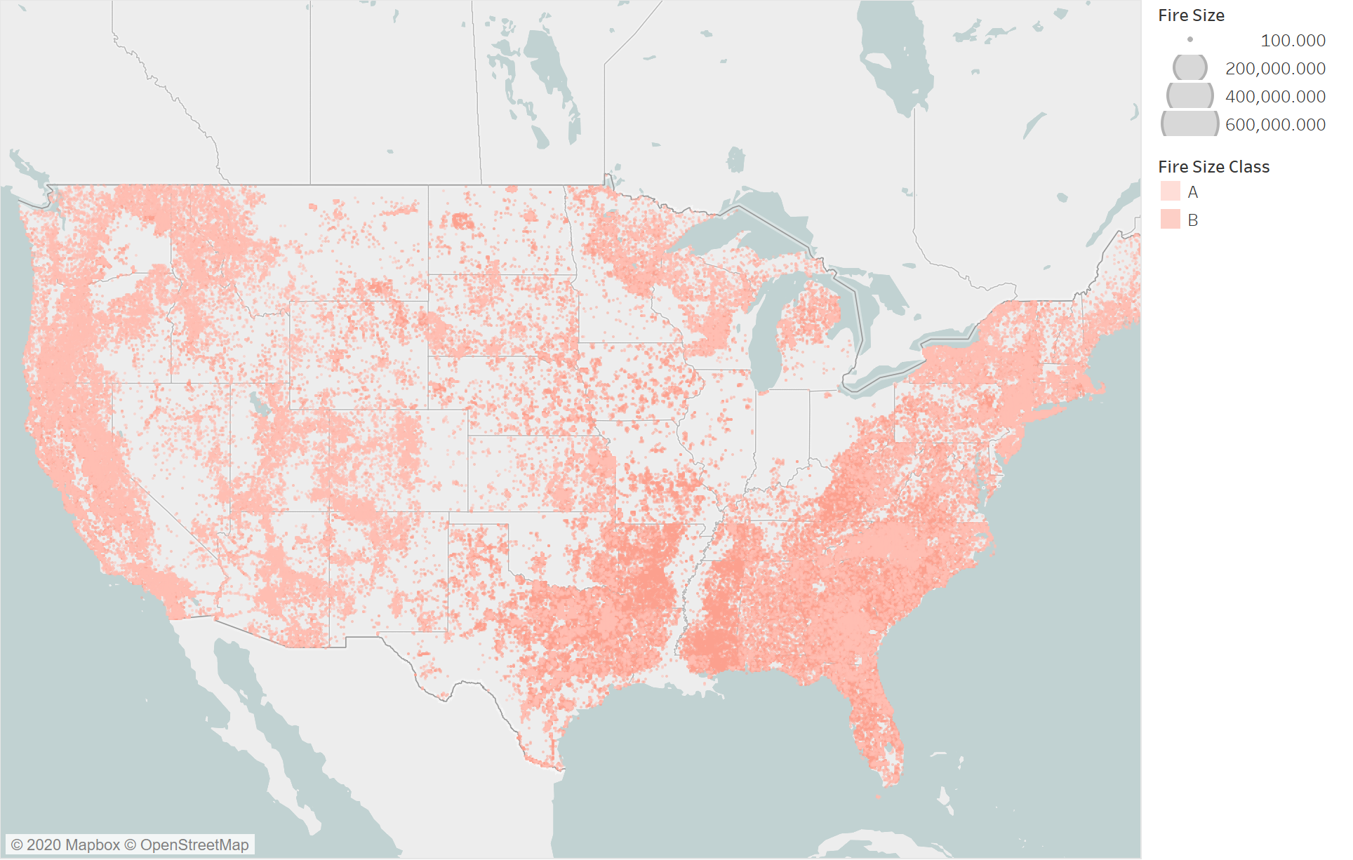
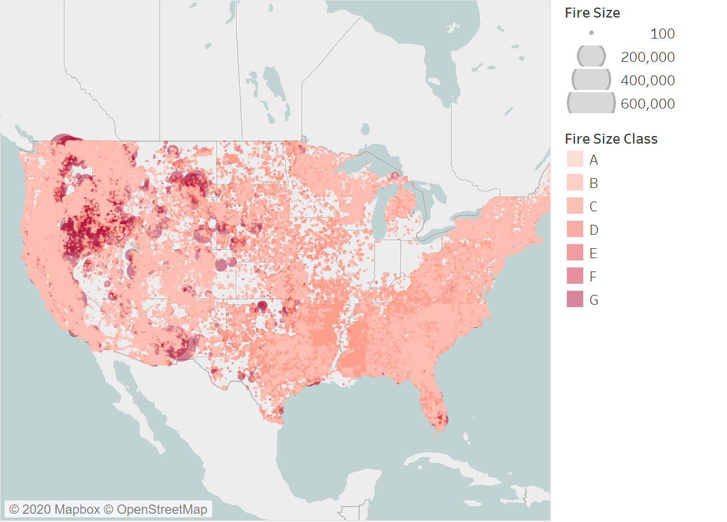
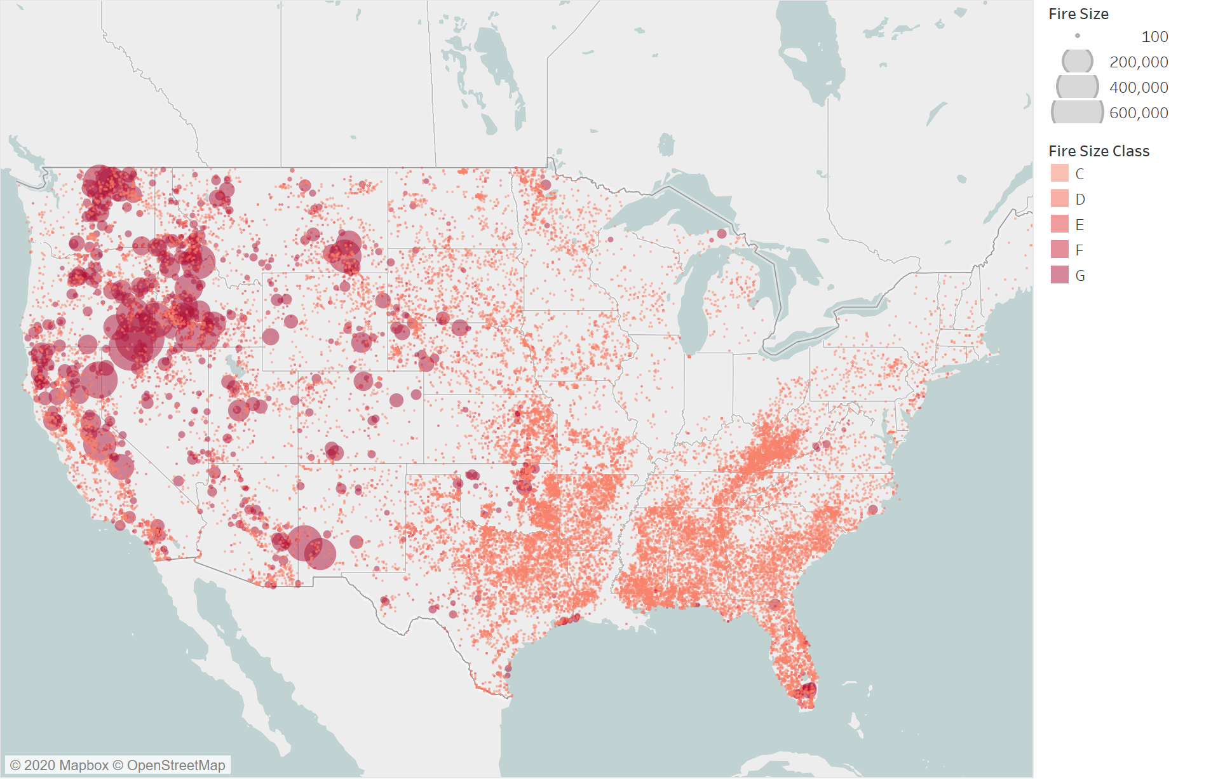
Splitting data into two sets
Fires < 10 acres
2012-2015 wildfires
Fires > 10 acres
Decided to split data into two sets rather than use a heatmap. Heatmaps overemphasized smaller fires relative to the acres burned, due to there being so much more of them.

Slide 6
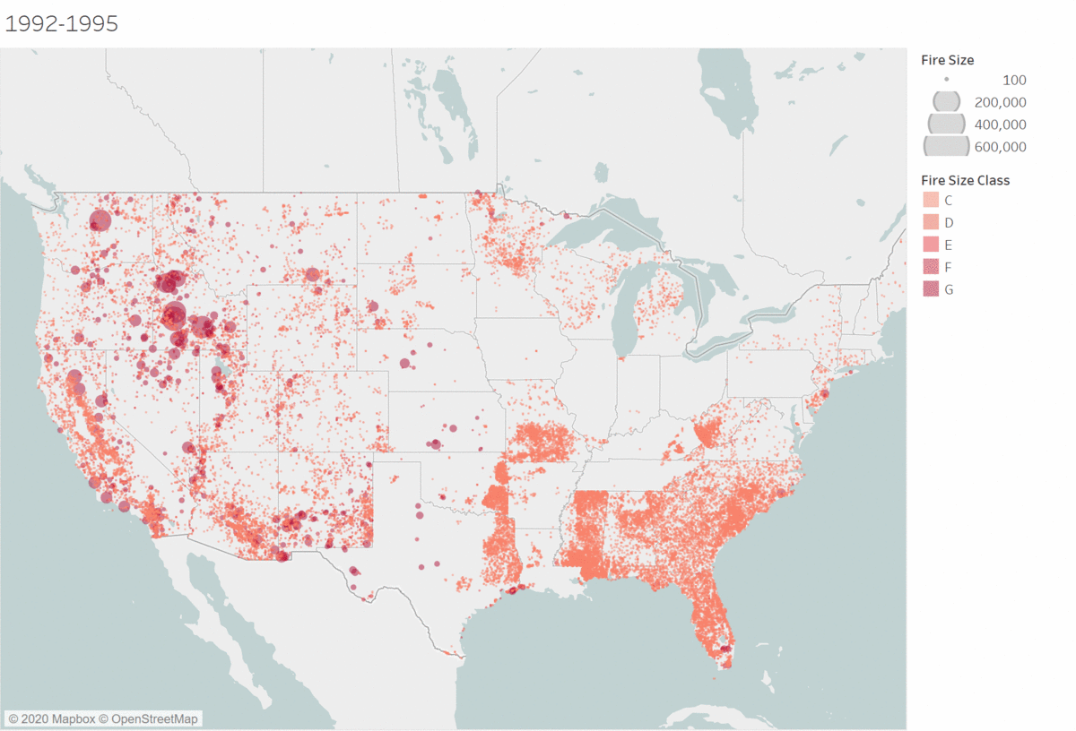

Fires greater than 10 acres over the years
The following maps split the fires into six, 4-year sections and displays them in sequential order.
The average fires size grew from 37.6 acres from 1992-95, to 97.6 acres from 2011-15.
The average number of acres burned annually grew from 2.6 million acres in 1992-95, to 6.9 million in 2011-15.

Slide 7
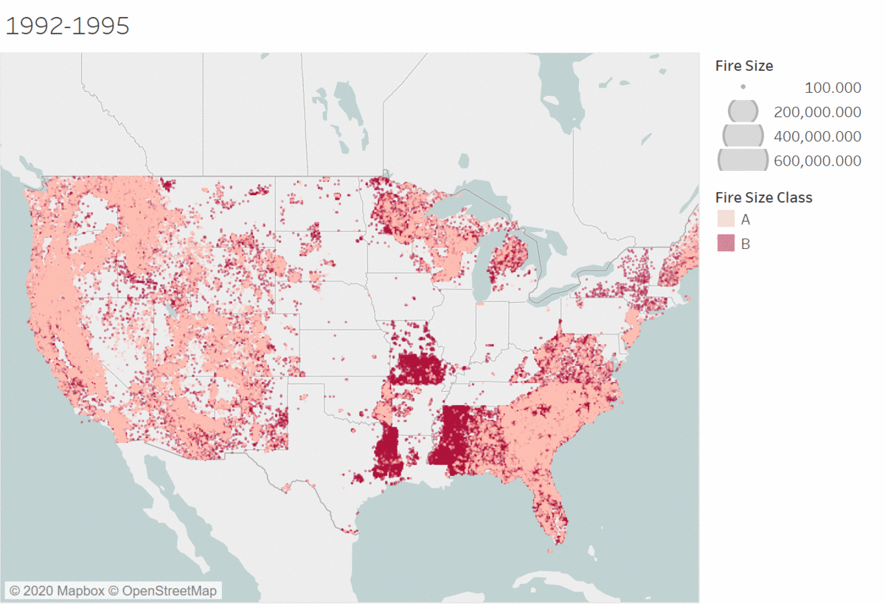
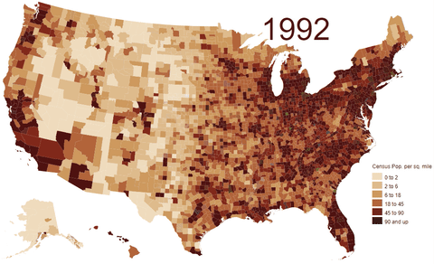
Small Fires Relation to Population Density
Population Density Map
*From US Census Bereua

Slide 8
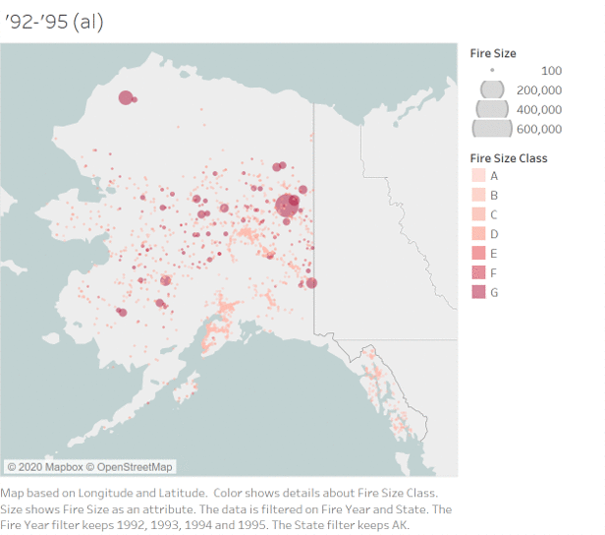
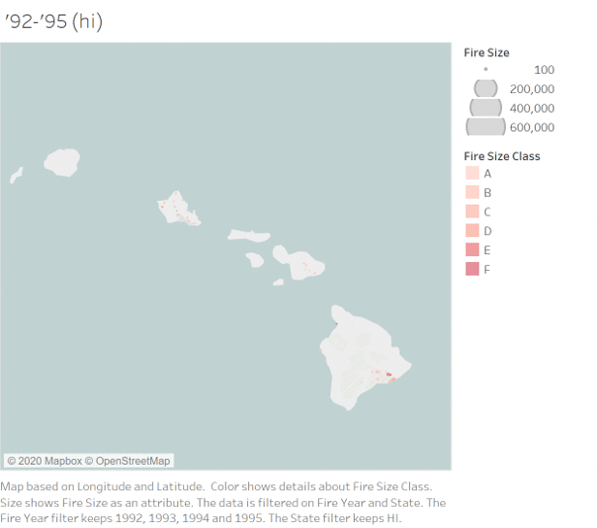
Alaska & Hawaii

Slide 9
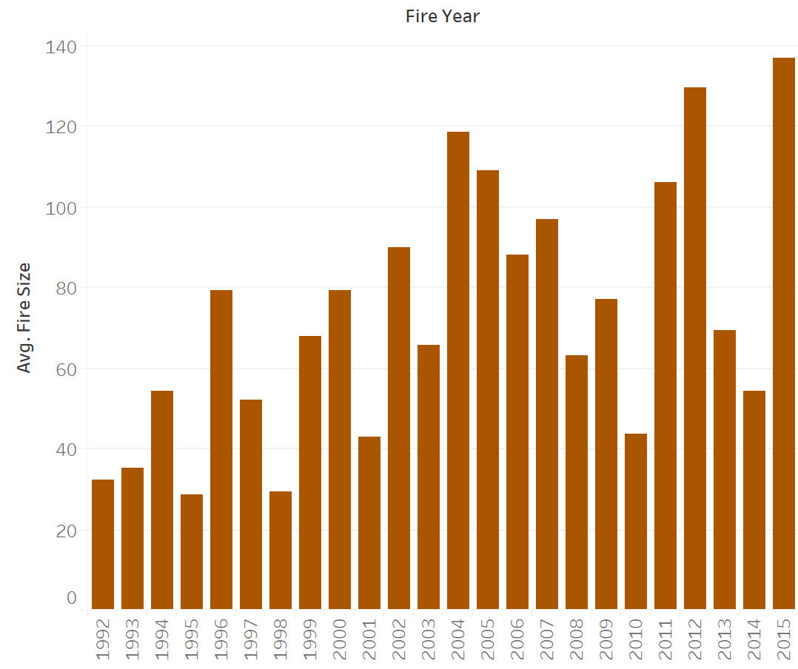
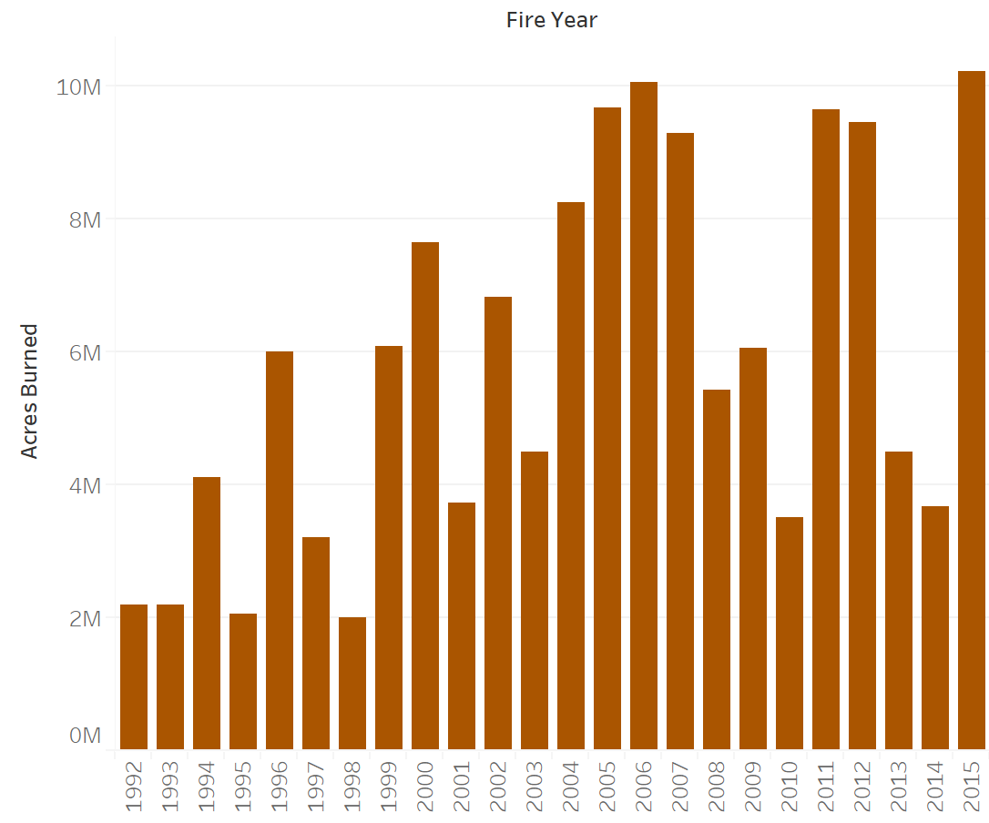
Fire Statistics
Average Fire Size vs Year
Acres Burned vs Year
* Upward trend in both average fire size and total acres burned annually **both charts are very similar

Slide 10
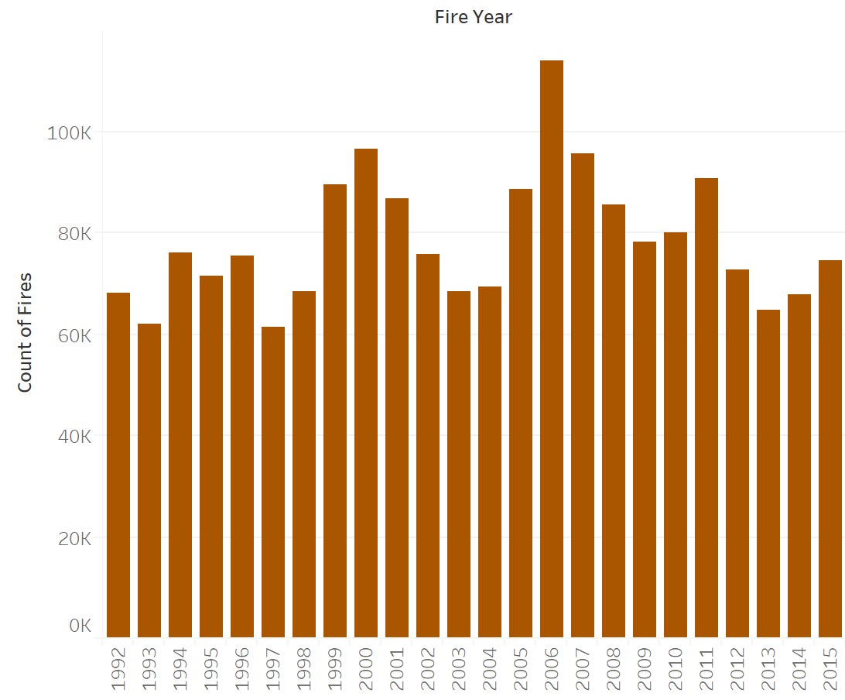
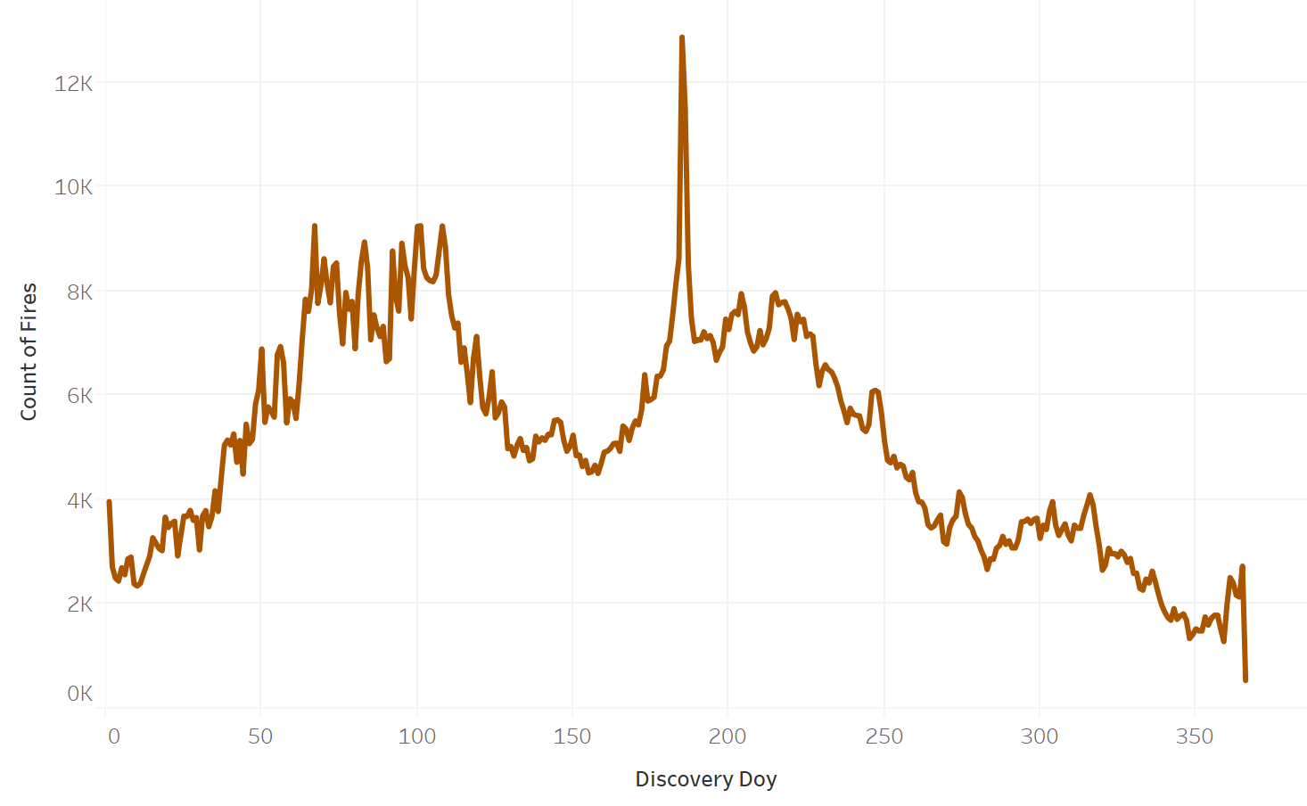
Fire Statistics
Number of Fires per Year
Fires by Day of Year
* No apparent trend in annual # of fires

Slide 11
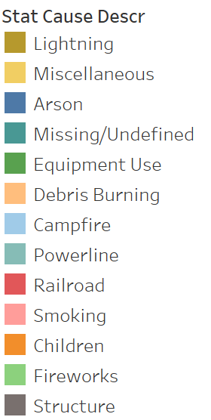
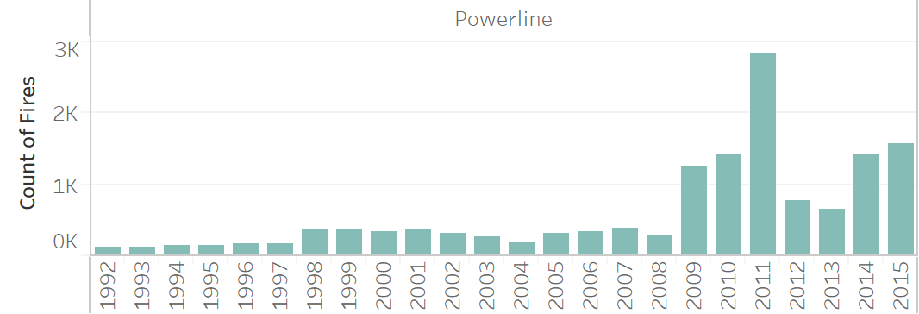
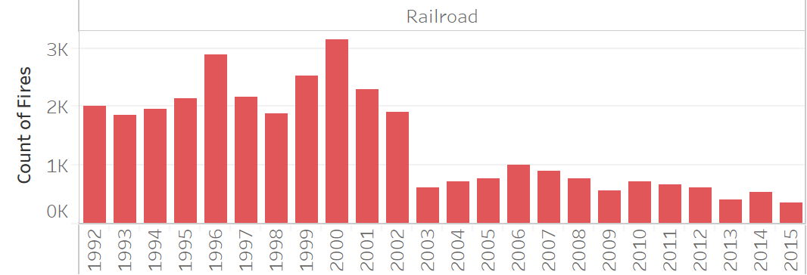
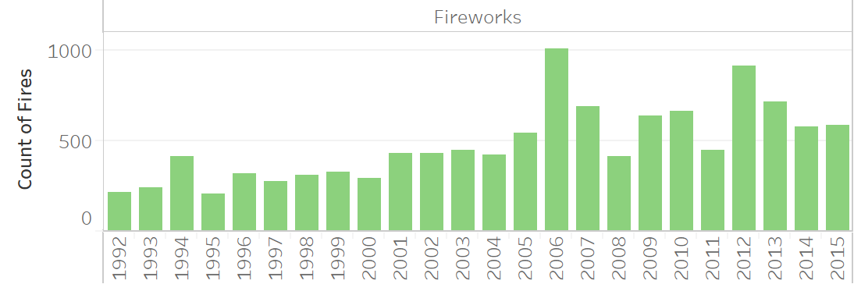
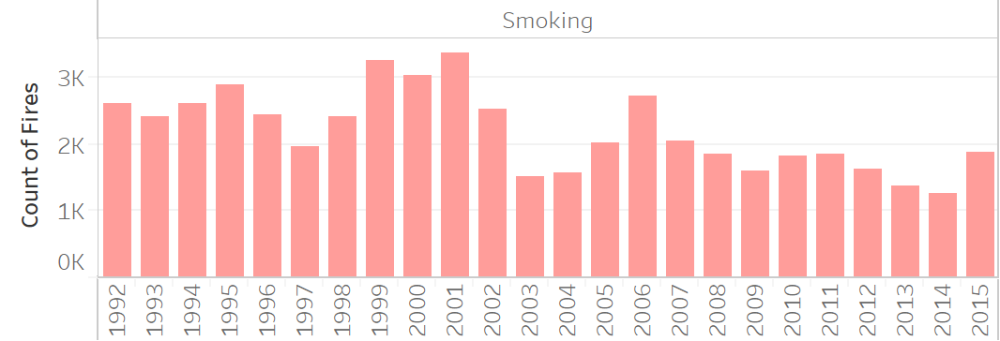
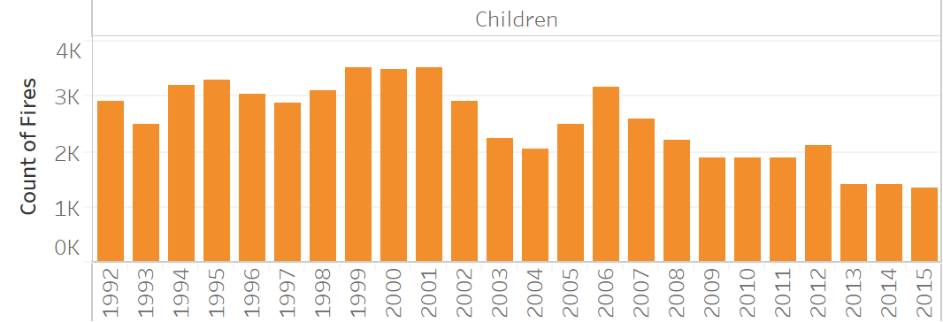
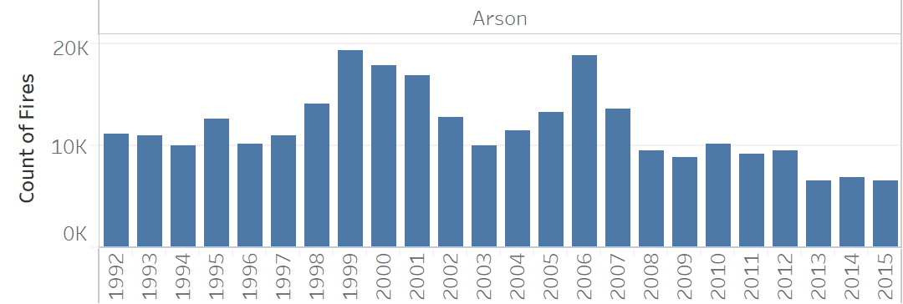
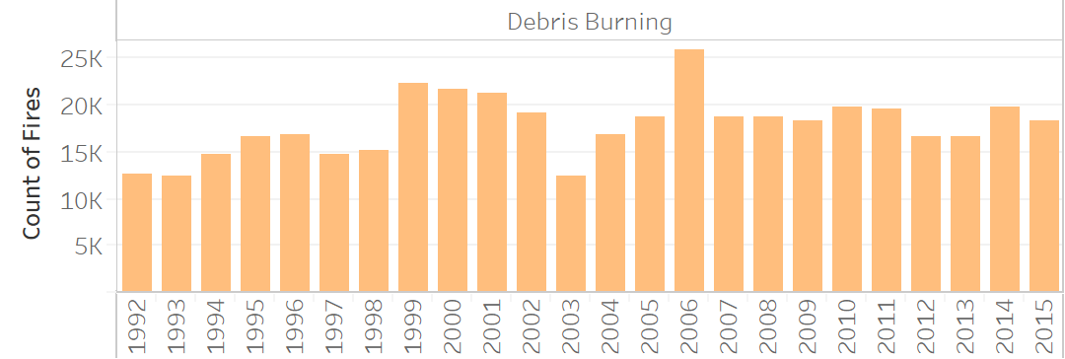
Statistics on Causes of Fires Over Time

Slide 12
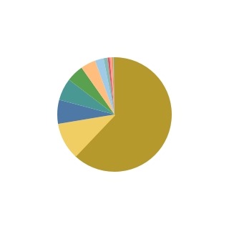
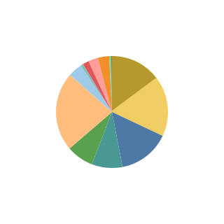
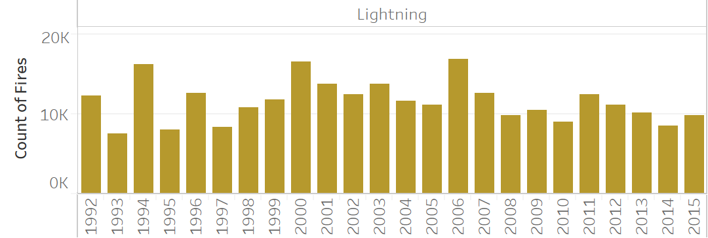


Impact of Lightning on Wildfires
Total Acreage Burned by Cause
Number of fires by cause
*representing 140 million acres
While there were trends in the number of fires started by each cause, the vast majority of acreage burned by wildfires are in lightning caused fires.

Slide 13
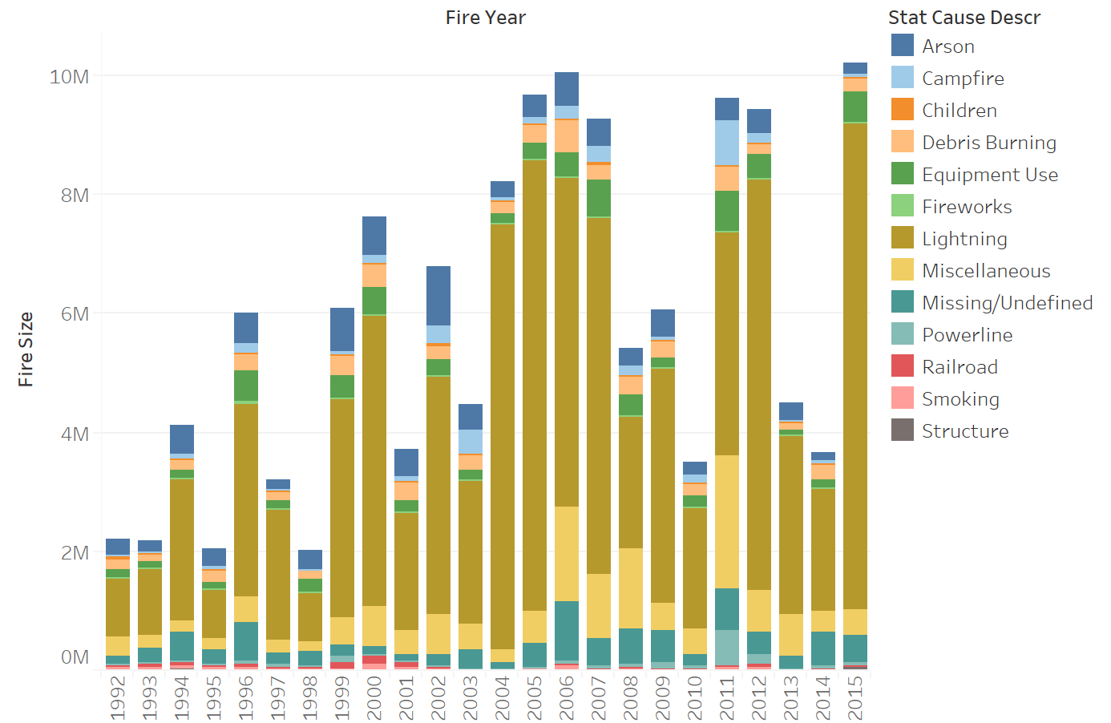
Impact of Lighting Caused Fires
Acres Burned vs Year
Acres Burned vs Year (w/ causes)

Slide 14
Bibliography
Short, Karen C. 2017. Spatial wildfire occurrence data for the United States, 1992-2015 [FPA_FOD_20170508]. 4th Edition. Fort Collins, CO: Forest Service Research Data Archive. https://doi.org/10.2737/RDS-2013-0009.4
Desjardins, Jeff. “Visualizing 200 Years of U.S. Population Density.” Visual Capitalist, 12 Mar. 2019, www.visualcapitalist.com/visualizing-200-years-of-u-s-population-density/.

